Slide 1


Tourism Management
Website Project
Group 4:
1. Koiy Bottra(Leader)
2. Oum Soknang
3. Chhay Lang
4. Smai Phouchhet
5. Ly Visal

Slide 2
http://projectsarena.com/tutorial/
References website or front end soft code or feature website
I. YouTube Link
II. Website Link
ttps://www.youtube.com/watch?v=_JiomDkizY0

Slide 3
List 5 important in my project
I. Menu Website
II. Gallery
III. Category
IV. User Form
V. Admin Form

Slide 4

I. Menu Website

Slide 5
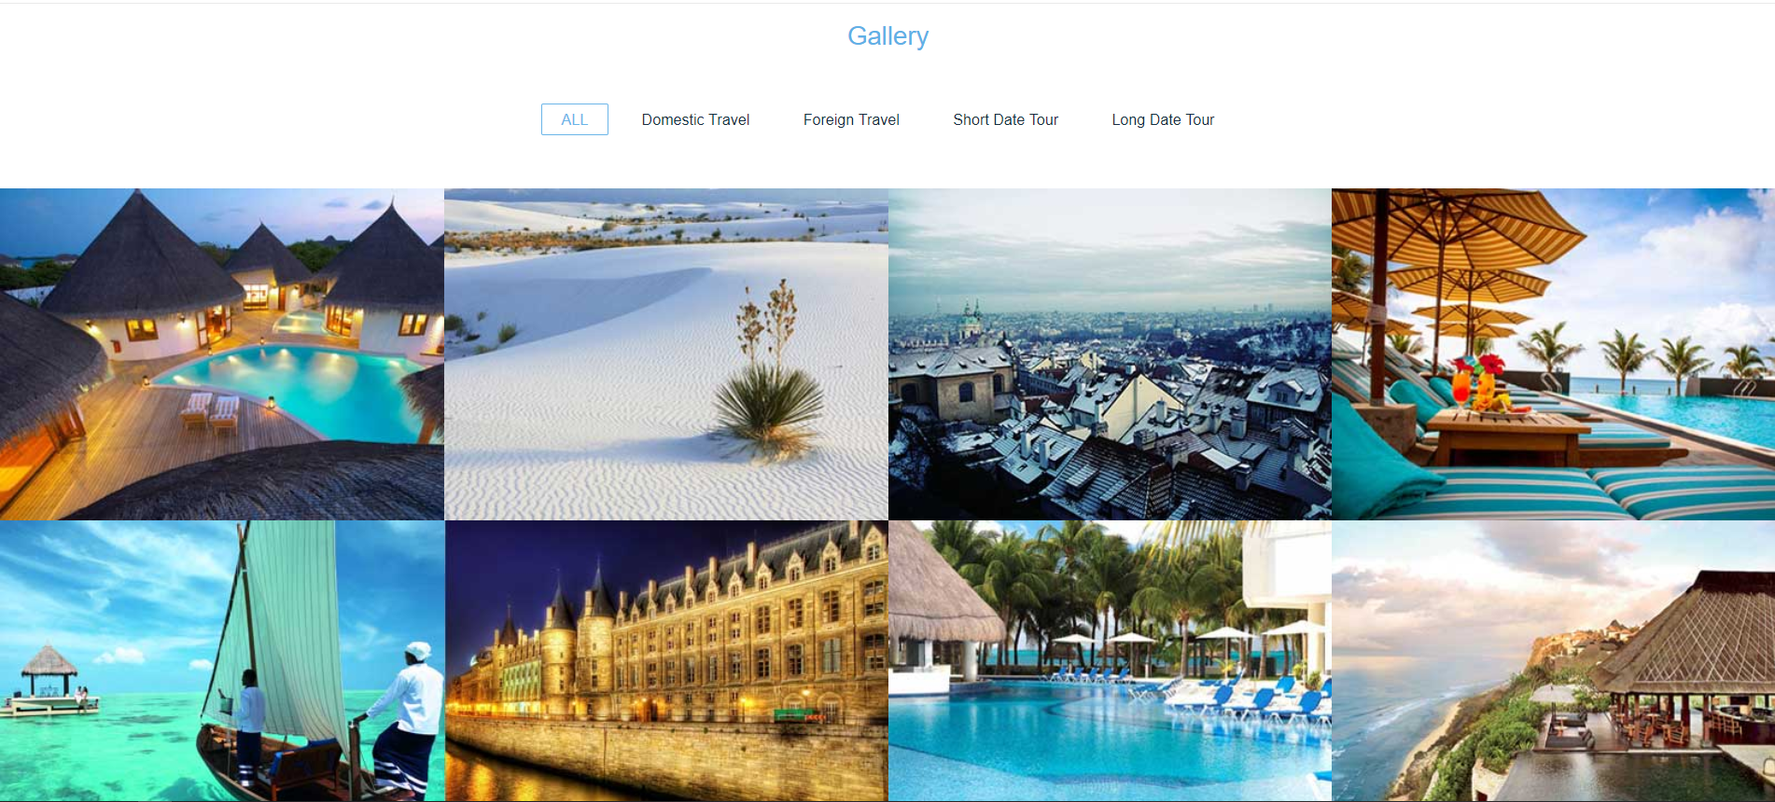
II. Gallery

Slide 6
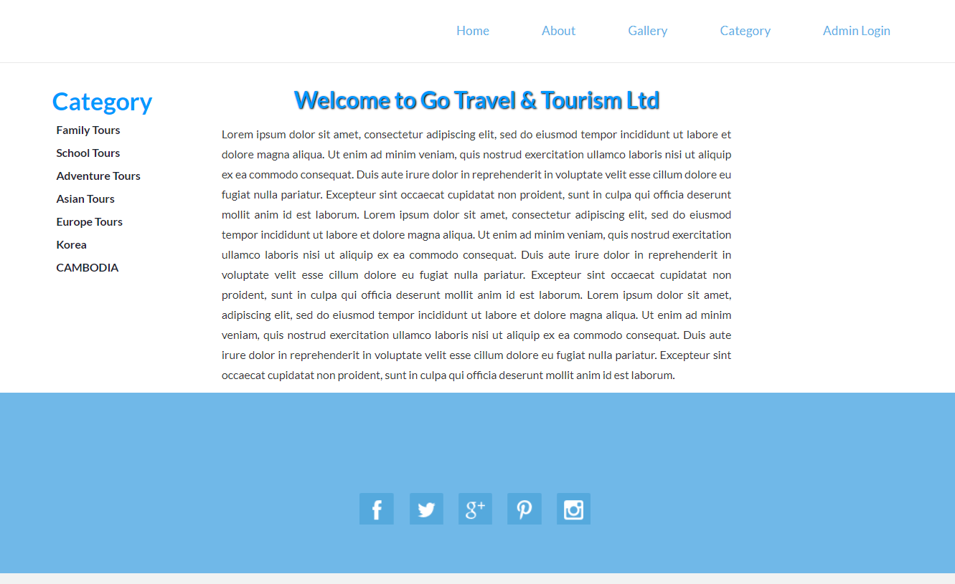
III. Gategory

Slide 7
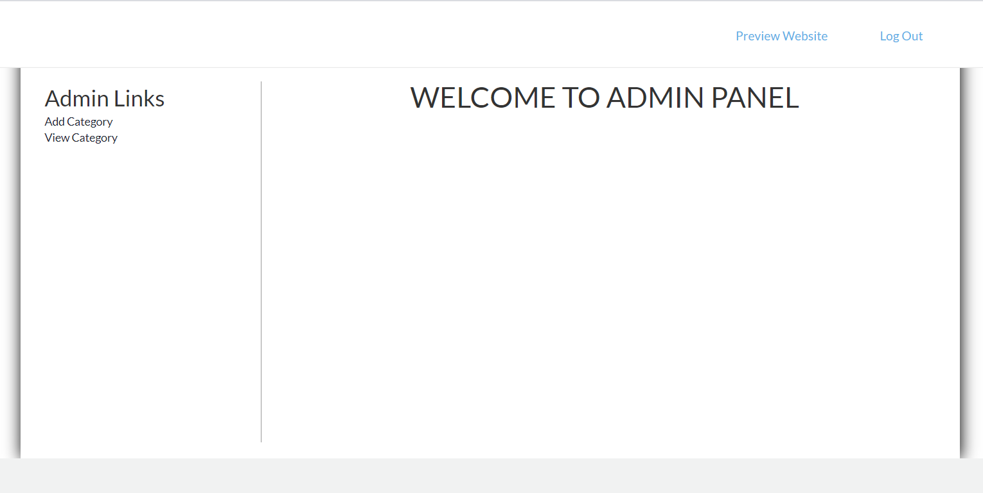
IV. User Form

Slide 8
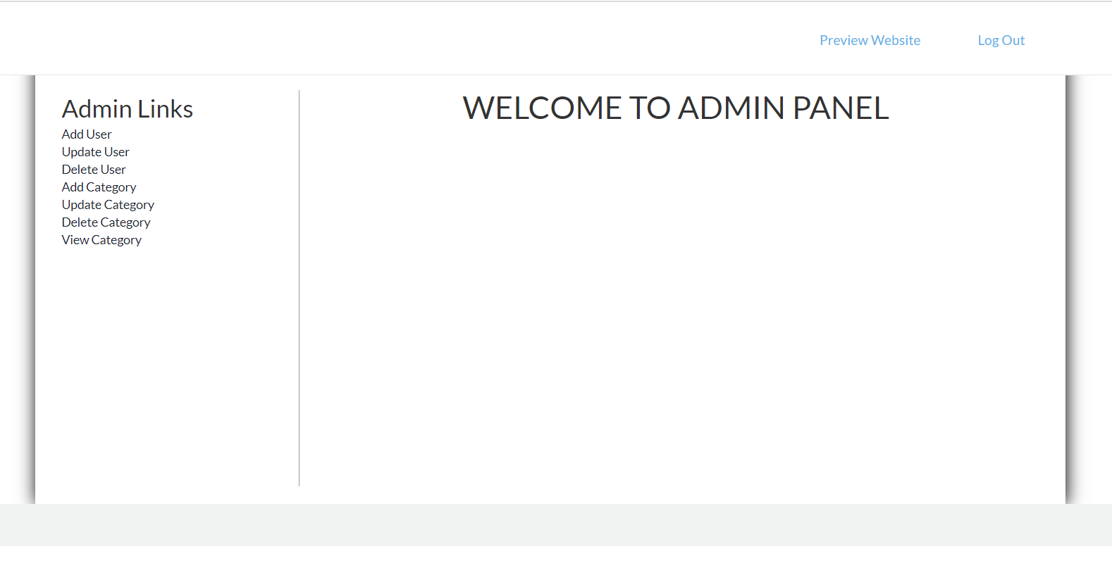
V. Admin Form

